Slide 1
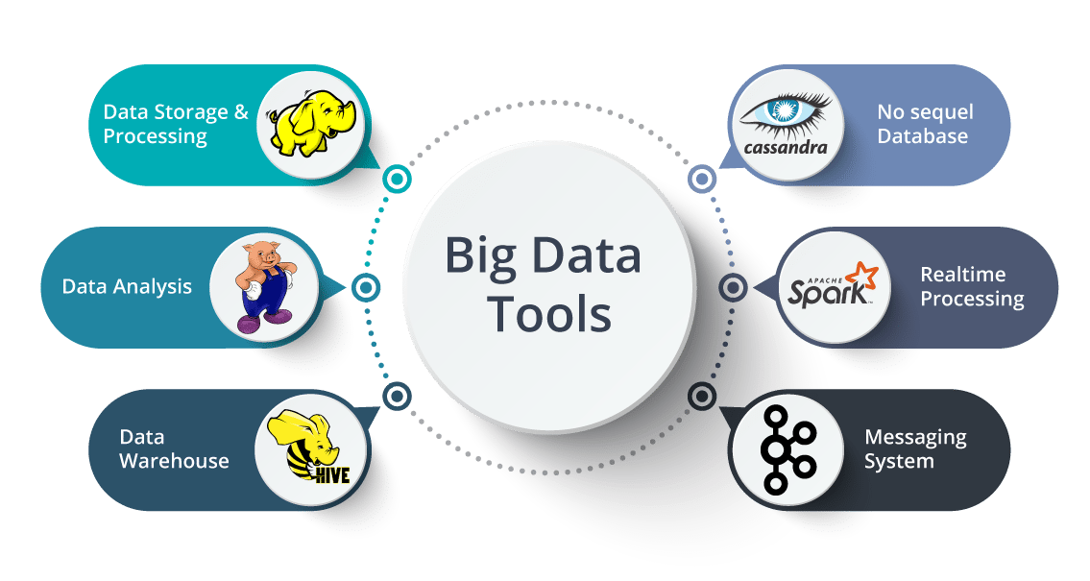
Big Data Storage and Processing MSc in Data Analytics CCT College Dublin
Introduction to Big Data Storage & Processing (BDSP)
Week 1
Lecturer: Dr. Muhammad Iqbal*
Email: miqbal@cct.ie

Slide 2
Agenda
Big Data Introduction
Characteristics and Understanding of Big Data
Types of Data: Transactional or Analytical
ACID vs BASE (Relational (Legacy approach) and Non-relational (NoSQL))
Big Data Architectures & Processing
Data and Storage Paradigm
Distributed Computing Overview
Requirements and Challenges: BIG DATA
MLO1: Critically assess the data storage and management requirements of a given data project from a modern perspective and evaluate limitations of legacy approaches to Big Data. (Linked to PLO 3)

Slide 3
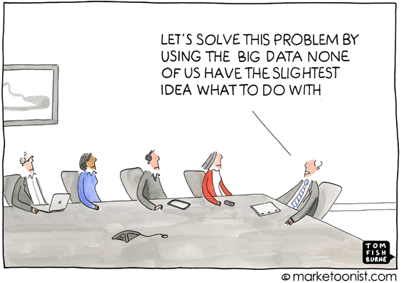
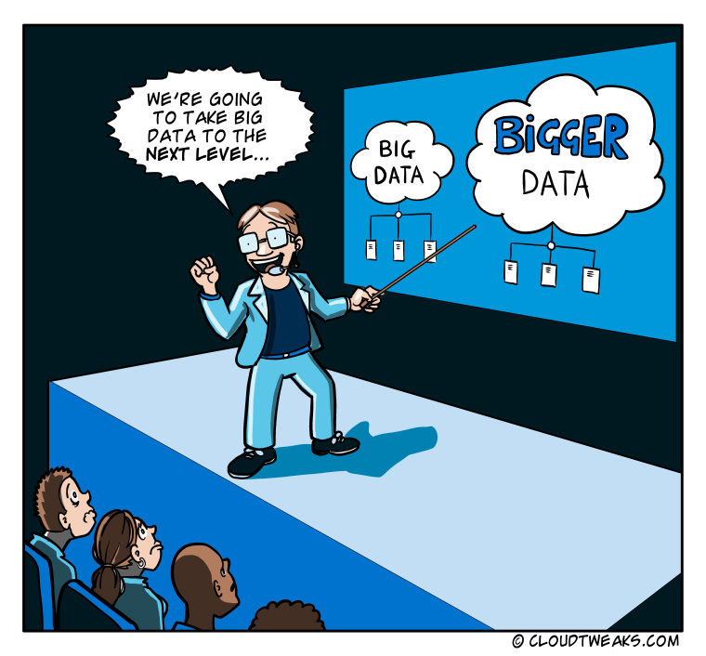
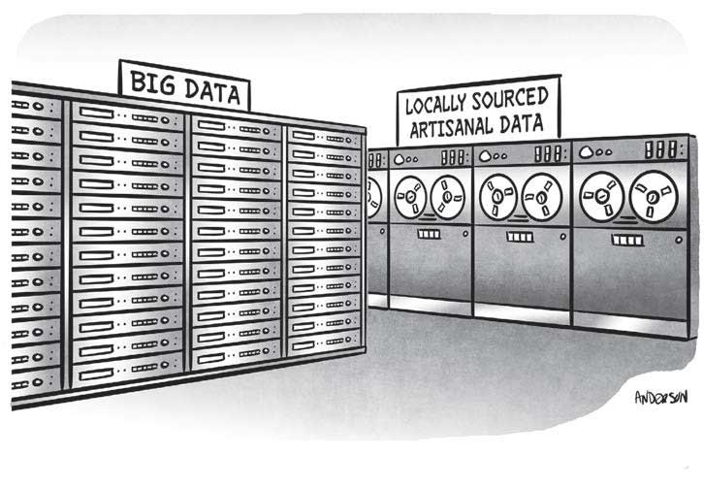
Big Data

Slide 4
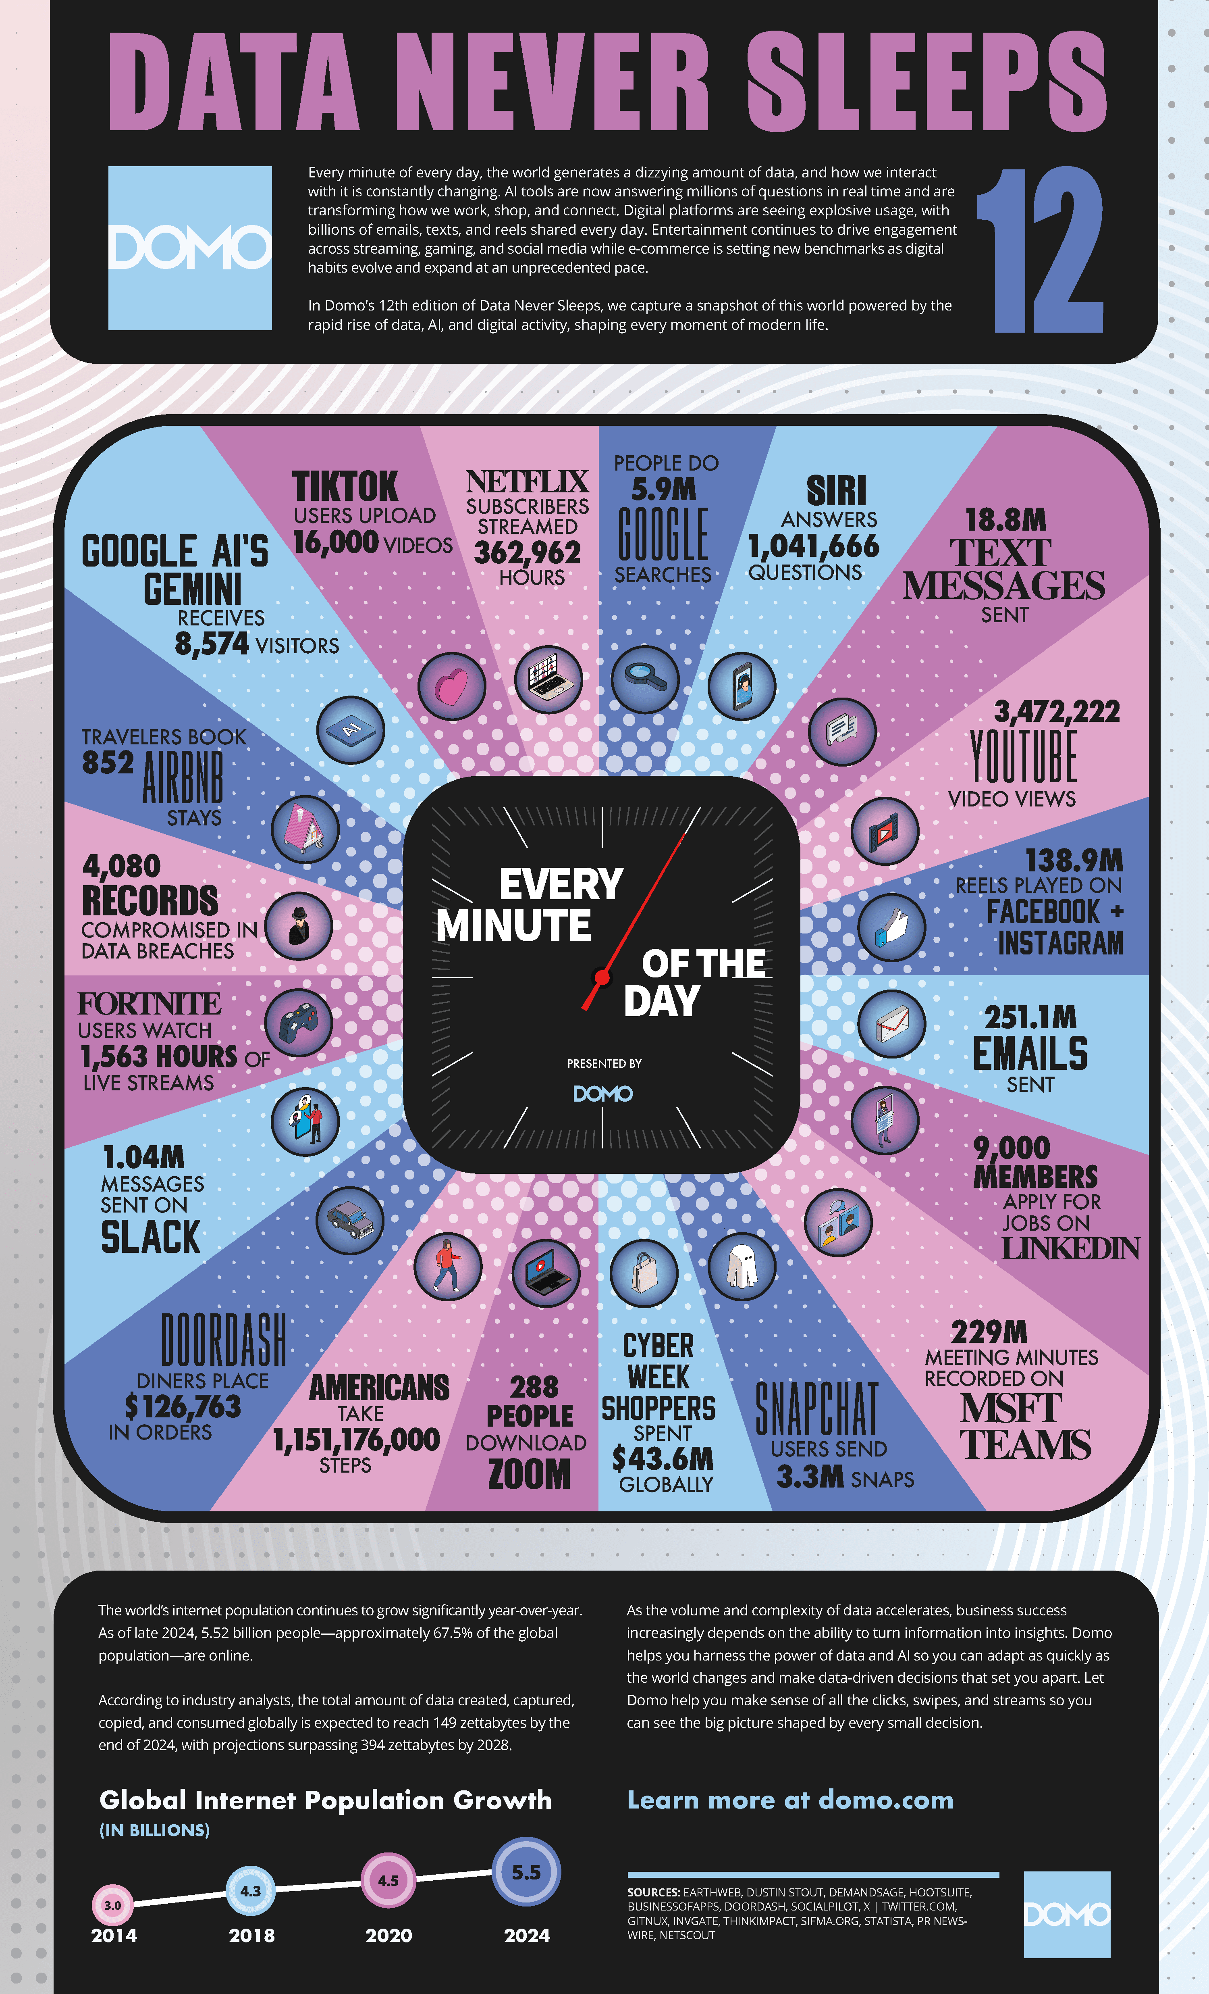
12th edition of Data Never Sleep
Big Data Context
More data is generated and consumed than ever before
Increased demands for processing, storage, bandwidth and I/O
Expectations increasing and the data will be available whenever and wherever required
Technology advancements
More data can be stored
Less energy required for storage
https://www.domo.com/learn/infographic/data-never-sleeps-12
Notes:
The coronavirus pandemic's effects on the growing digitization of daily life and how technology is assisting in reimagining the future of employment are both highlighted in 11th edition of Data Never Sleeps.

Slide 5
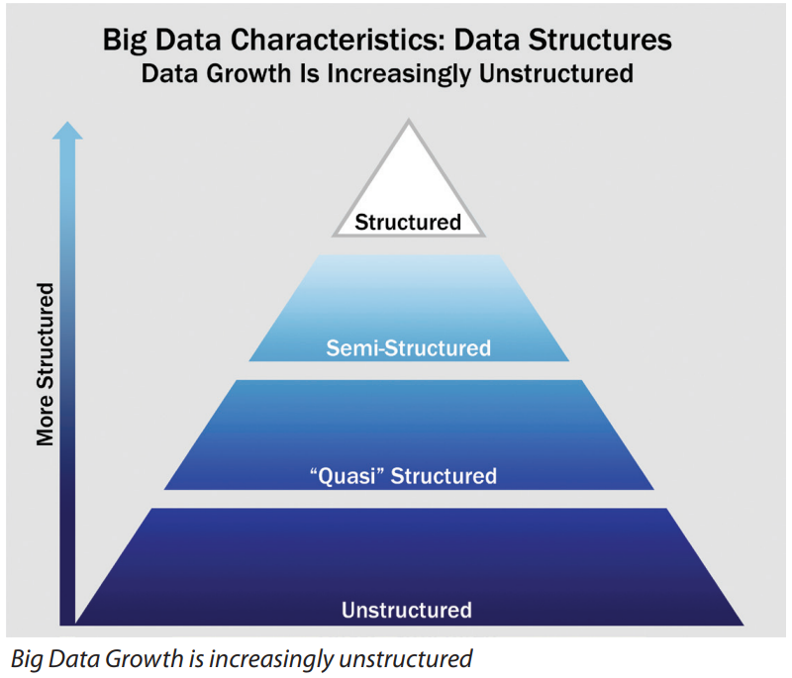
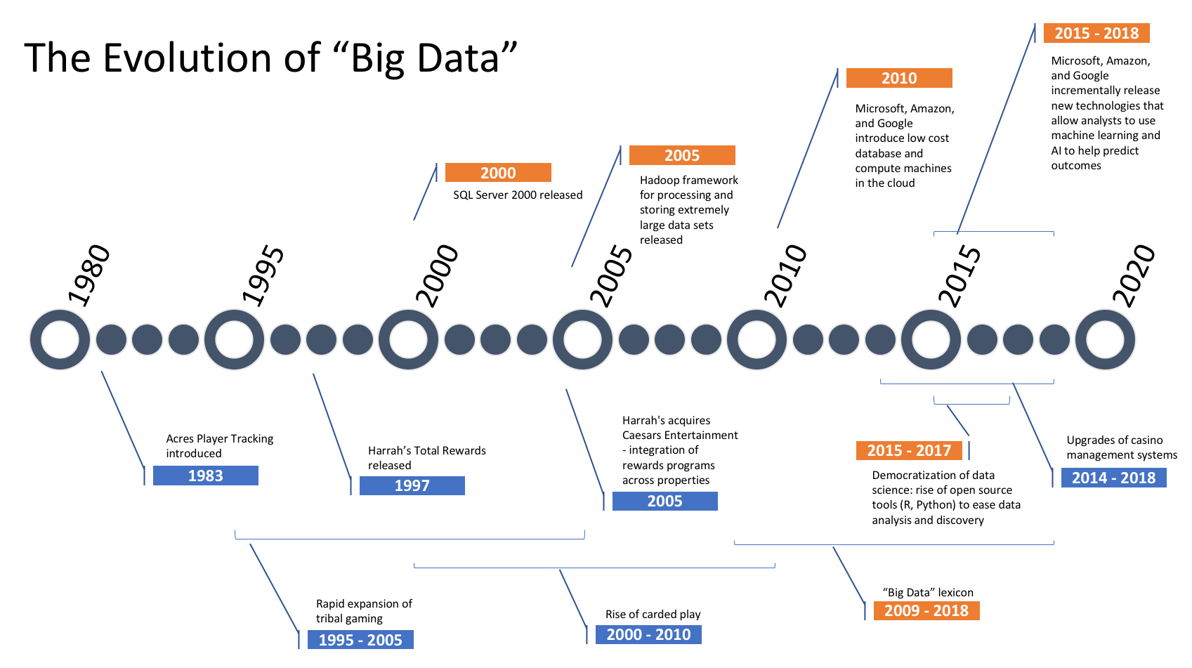
Introduction to Big Data
BIG DATA has been increasingly used in our daily lives. From social networks to mobile applications, and internet search, a huge amount of data is being generated, collected, and processed.
The term "Big data" refers to a huge and complicated data collection that is challenging to analyze with typical data processing software or readily available database management systems (RDBMS).
The data is evolved from the relational database management system storage to NoSQL storage.
Notes:
Structured data: Data containing a defined data type, format, and structure (that is, transaction data, online analytical processing [OLAP] data cubes, traditional RDBMS, CSV files, and even simple spreadsheets).
Semi-structured data: Textual data files with a discernible pattern that enables parsing (such as Extensible Markup Language [XML] data files that are self-describing and defined by an XML schema).
Quasi-structured data: Textual data with erratic data formats that can be formatted with effort, tools, and time (for instance, web clickstream data that may contain inconsistencies in data values and formats).
Unstructured data: Data that has no inherent structure, which may include text documents, PDFs, images, and video.

Slide 6

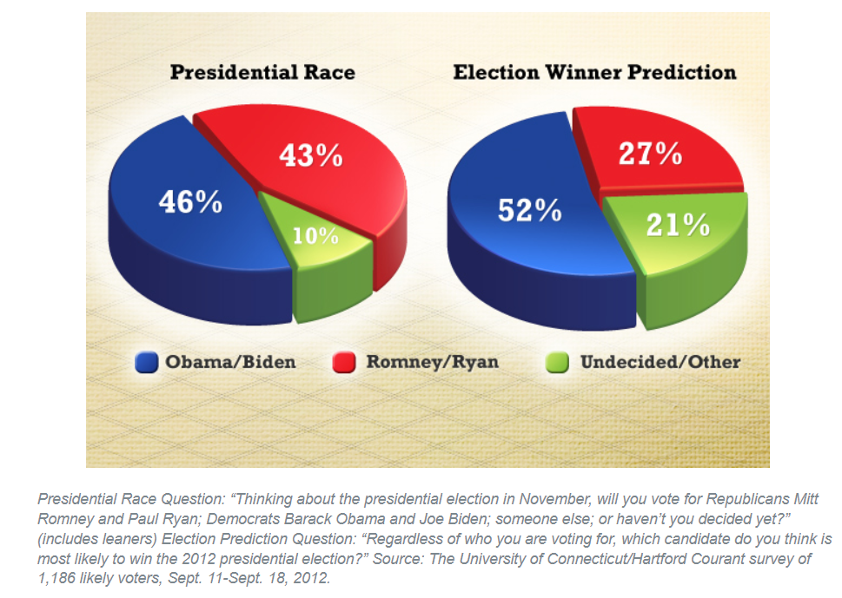
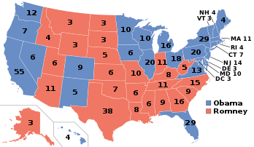
Introduction to Big Data
In 2006, LinkedIn, the social networking giant, started analyzing profiles of its users by suggesting people they may know.
The aim behind this concept was to motivate users to broaden their social networks based on their interests and provide them with useful ideas. By putting this idea into practice, LinkedIn discovered that the majority of its recommendations for inviting people were fruitful.
In 2012, for US presidential elections, President Obama’s campaign experienced massive boost and success through predictive analysis using a Big dataset consisting of voter’s profiles, their likes, and their patterns.
BIG DATA has a huge potential for information extraction and it only possible thorough understanding and implementation of available systems that are used for storing, processing, linking, and analyzing.

Slide 7
Characteristics of Big Data
Big data can be characterized by identifying some important characteristics and these are referred to as five V’s of Big data.
Volume: Big data refers to the massive volume of data such that the amount of data challenges the storage and processing requirements. From Terabytes (10¹²) to exabytes (10¹⁸).
Velocity: Data is being generated at a very fast pace. The high rate of data generation signifies the importance of data.
Variety: Data under consideration could be obtained from numerous sources, such as web logs, user tweets, and search patterns etc. Similarly, data could have different formats such as CSV, tables, text documents, and graphs.
Veracity: Veracity refers to the trustworthiness, accuracy, or authenticity of data.
Value: Data must be of high value; i.e., stale data has limited value.
Notes:
Big data can be characterized by identifying some important characteristics and these are referred to as five V’s of Big data.
Volume: Big data refers to the massive volume of data such that the amount of data challenges the storage and processing requirements. While there is no specific distinction about the volume of data, normally the volume could vary from Terabytes (10¹²) to exabytes (10¹⁸) and beyond.
Velocity: Data is being generated at a very fast pace. The high rate of data generation signifies the importance of data. The high velocity of data can be assessed by the fact that a large proportion of data being used belong to the recent past.
Variety: Data under consideration could be obtained from numerous sources such as web logs, Internet of Things (IoT) devices, URLs, user tweets, and search patterns etc. Similarly, data could have different formats such as Comma Separated Values (CSV), tables, text documents, and graphs. Further, it could either be structured, semi-structured, or unstructured.
Veracity: Data may vary in terms of veracity; i.e., data under consideration may be inconsistent or it may be highly consistent across all replicas; it may be useless or it may be of high value. Veracity refers to the trustworthiness, accuracy, or authenticity of data.
Value: Data must be of high value; i.e., stale data has limited value.
Variability: Variability refers to data whose meaning is constantly changing. Evidently, “great” on its own is not a sufficient signifier of positive sentiment. Instead, companies have to develop sophisticated programmes which can ‘understand’ context and decode the precise meaning of words through it.
Visualization: Visualization is critical in today’s world. Using charts and graphs to visualize large amounts of complex data is much more effective in conveying meaning than spreadsheets and reports chock-full of numbers and formulas.

Slide 8
Understanding Big Data
The term Big data refers to the huge amount of data such that we could organize, manage, analyze, and understand trends and patterns in data at volumes and rates that push the frontiers of current technologies.
One of the fundamental questions in Big data is that for a given Big data problem in consideration
How much data is enough?
How much data is needed to be analyzed in order to compute the result?
The answer to this question is not trivial. For example, opinion polls are based on data samples. In a similar context, gender-wise assessment and population are based on data sampling. Sampling increases the chance of error.
Notes:
Google Flu Trends (GFT)
We consider a scenario that is based on where the data sample collected may not reflect true results.
In 2009, Google tracked the spread of Flu in the United States. The prediction was based on GFT, the search trends available on Google. The prediction was so successful that it outnumbered the prediction from the Center for Disease Control (CDC).
In 2013, a similar prediction appeared as erroneous. It was observed that the GFT prediction was overstated by a factor of more than two. The problem was that Google’s algorithm was simply considering the search terms on the Google Search Engine. It was assumed that all the related searches made on Google are related to spread of flu. The Google team was unable to find the correlation between search terms and flu.
Consider a situation based on the data collected for election tweets, the data may provide a favour to a specific candidate.
Suppose the voters of the candidate are pro-active on social media as compared to the voters of other candidates.
Similarly, sample size in any Big data problem could have its own biases.
Determining the correct size of data for a given Big data problem is not trivial. In addition, collecting or gathering the complete data is also an issue.
We address the Big data problems and analyze on the available data – a term which is referred to donate the data which has found for analysis.
In the case of collecting more data is often more useful for analysis; it is not necessary that more data would yield improved results. In this context, relevance of data being collected is also important.

Slide 9
Questions and Discussion
On Data 12th edition of Never Sleeps illustration, In every minute, how many users sent text messages?
On Facebook and Instagram, how many reels played on?
How many (3 or 5 or 7) characteristics a Big data has?
What is your understanding on Big Data now?

Slide 10
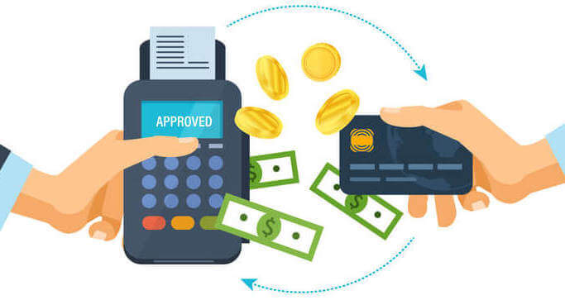
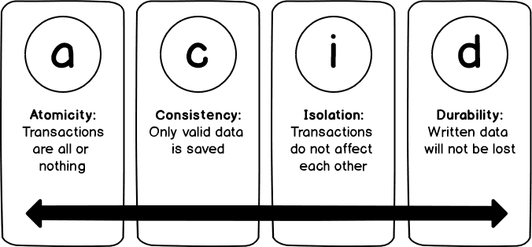
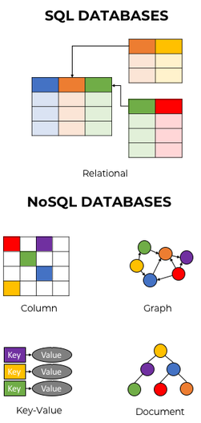
Types of Data Transactional or Analytical
Transactional Systems: These are the types of systems which support transaction processing. Such kind of systems adhere to ACID (Atomicity, Consistency, Isolation, and Durability) properties. They have proper schema and data for each transaction is uniquely identified.
Analytical Systems: Data does not necessarily adhere to a proper schema. It may have duplicates and missing values etc. Such systems are more appropriate for analyzing data.
The term Big data has been associated for analytical systems because such systems do not require strong consistency and have schema-less data with duplicates, multi-formatting, and missing values.
Notes:
Ask the students to use chatGPT/ DeepSeek to find the examples for ACID.

Slide 11
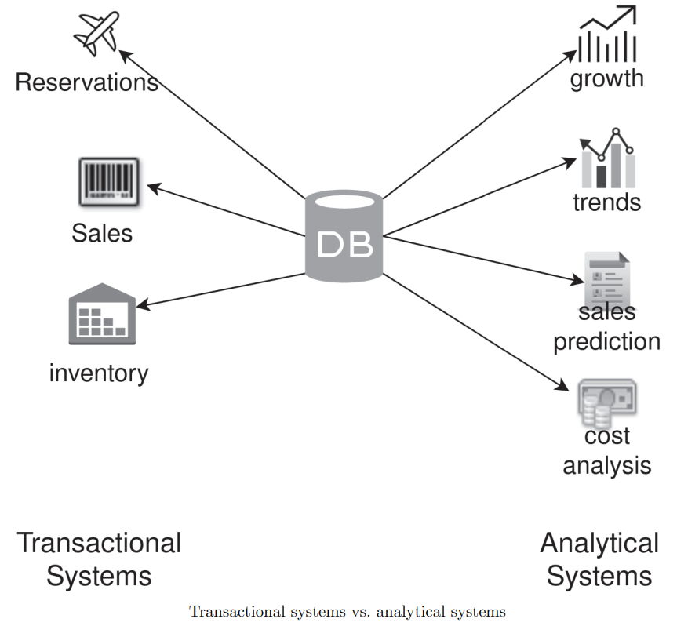
ACID vs BASE
For distributed systems, meeting ACID guarantees is really challenging. Therefore, many Big data systems employ BASE properties.
BASE is an acronym for Basically Available Soft state Eventual consistency.
BASE implies that in case of network failure, Big data systems tend to compromise on consistency in order to provide availability.
The main focus of such systems is to ensure availability, whereas eventual consistency model is followed.

Slide 12
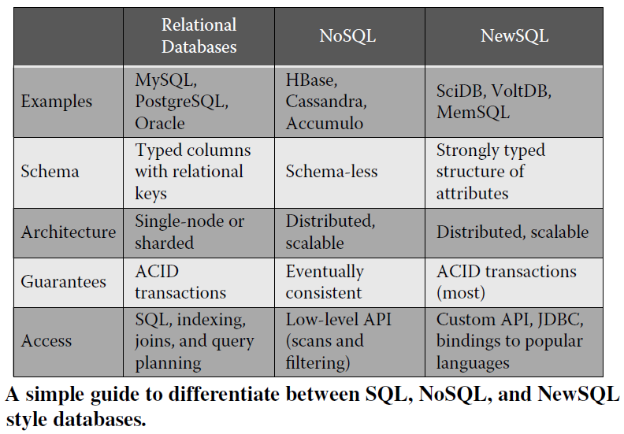
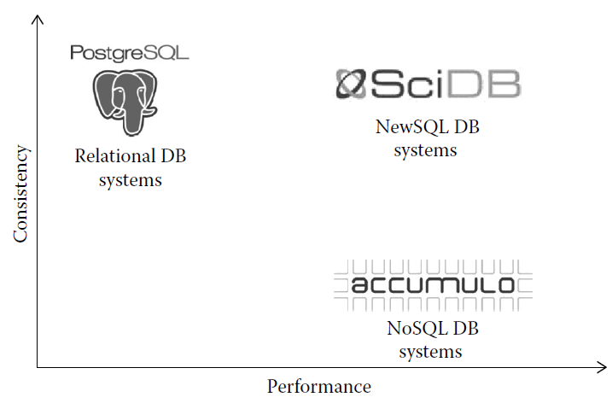
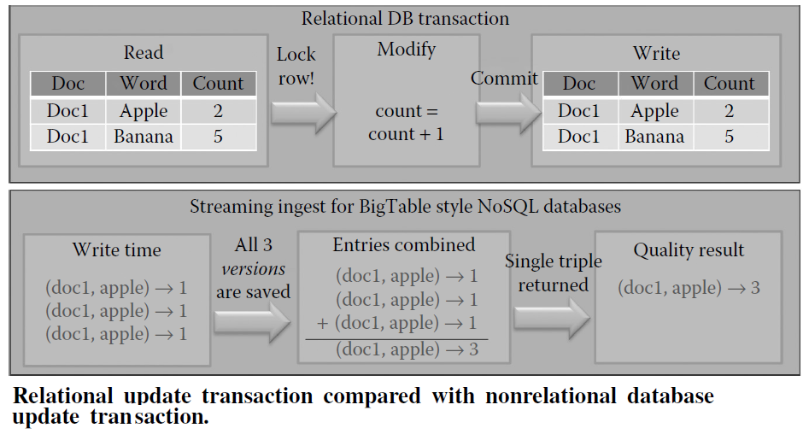
Databases Relational and Non-relational
Traditional relational databases provide high consistency.
NoSQL databases provide high performance at the cost of consistency, and NewSQL databases attempt to bridge the gap.
Notes:
NewSQL is a class of relational database management systems that seek to provide the scalability of NoSQL systems for online transaction processing (OLTP) workloads while maintaining the ACID guarantees of a traditional database system.
NewSQL databases aim to bridge the gap between these two worlds:
Scalability
SQL Interface
ACID Compliance
Performance
Examples of NewSQL Databases
Google Spanner, CockroachDB, VoltDB

Slide 13
Questions and Discussion
How many kinds of major databases you have identified so far?
What are the differences between ACID and BASE?

Slide 14
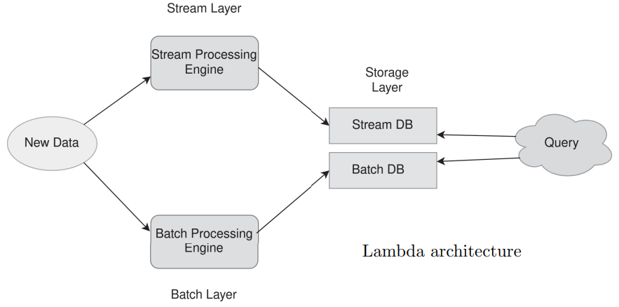
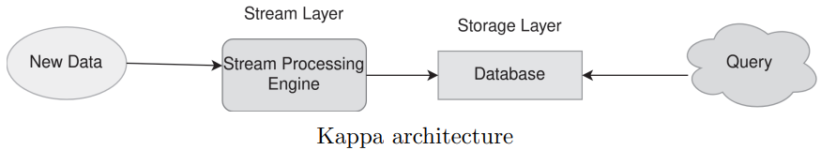
Big Data Architectures
Different architectures can be used for Big data processing.
We introduce two major architectures used in Big data.
An efficient real time data processing architecture needs to be scalable and fault-tolerant and it should support batch and incremental updates. The kinds of architectures are mentioned below
Lambda Architecture
Kappa Architecture
Notes:
Lambda Architecture:
To deliver precise and current insights, the Lambda Architecture is built to manage both batch and real-time data processing. The batch layer, the speed layer, and the serving layer are the three layers that make it up.
Real-World Example: Social Media Analytics
Imagine a social media platform like Twitter. It generates a massive amount of data in real-time, including tweets, user interactions, and trending topics. The Lambda Architecture can be applied to analyze this data:
Batch Layer: In order to create batch views, the batch layer gathers and analyses past data. Aggregating data, computing statistics, and creating precomputed data sets may all be required. For instance, the batch layer could examine past tweet data to identify trending hashtags over time.
Stream Layer: Processing of data in real-time is handled by the Stream layer. It instantly evaluates incoming data streams and offers in-the-moment insights. In our example, the speed layer might be in charge of processing incoming tweets, spotting trends, and instantly updating the trending topics.
Storage Layer: The serving layer combines the results from both the batch and speed layers to provide a unified view of the data. In our example, this could involve presenting both historical and real-time trending topics to users, allowing them to explore the data.
Kappa Architecture:
A more reduced method that only concentrates on real-time data processing is the Kappa Architecture. It does away with the Lambda Architecture’s. Lambda Architecture's complexity of maintaining both batch and real-time processing layers.
Real-World Example: Internet of Things (IoT) Data Processing
Think about the implementation of a smart city with IoT sensors dispersed over the city to track energy use, air quality, and traffic. Processing this continuous stream of data can be done using the Data Ingestion: The system streams data from sensors to a streaming platform like Apache Kafka in real time.
Processing and Analysis: The incoming data streams are processed and analysed by the streaming platform. For example, it might immediately identify trends of traffic congestion, abnormalities in the air quality, or increases in energy consumption.
Real-Time Insights: To help city authorities make quick, educated decisions, the processed data can be used to give them real-time insights. For instance, based on the patterns of existing congestion, traffic control systems could be changed in real time.
Storage and Further Analysis: Additionally, processed data can be kept for potential future examination. This archived data can be utilised for historical comparisons, trend research, and other purposes.

Slide 15
Big Data Processing
How can we effectively address the challenges associated with BIG Data?
Build Bigger and more powerful machines
Although technological advancements have made possible for the storage of vast amounts of data, there are still some technological limitations that impact on how that data can be used.
Typical Hard Drive from 1990
1370 MB capacity
4.4 MB/s transfer speed
Five minutes required to read a full drive
2022
1 TB capacity
100 MB/s transfer speed or 200 MB/s
2.9 hours or 1.45 hours required to read full drive
Notes:
1370 MB /4.4 = 311.4 seconds => 311.4/60 = 5.2 Minutes
1024 * 1024 / 100 = 10485.76 seconds => 10485.76/60/60 = 2.9 hours

Slide 16
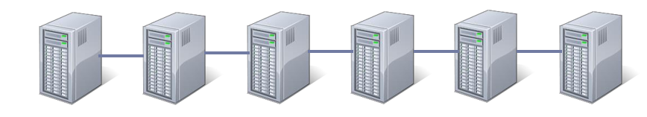
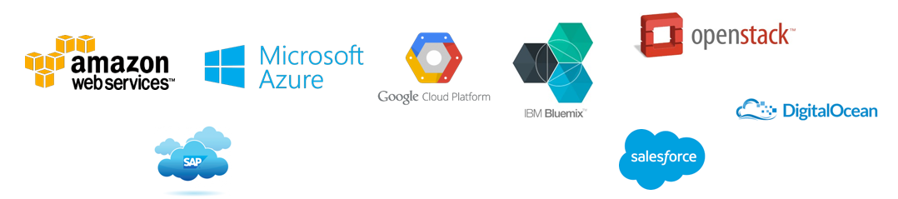
Big Data Processing
How can we effectively address the challenges associated with BIG Data?
Use a collection of reasonably powerful machines in concert
Various Cloud platforms are available to help with processing BIG DATA
Notes:
1370 MB /4.4 = 311.4 seconds => 311.4/60 = 5.2 Minutes
1024 * 1024 / 100 = 10485.76 seconds => 10485.76/60/60 = 2.9 hours

Slide 17
Big Data Processing Distributed Systems
The most popular Big data processing technique using clusters of computers is MapReduce.
Is a programming model that can be implemented using HADOOP framework and others.
Has two steps: Map & Reduce
Divide the data into chunks and split them by the computers into the clusters.
Expected characteristics of Distributed Systems
Resource sharing
Openess
Concurrency
Scalability
Fault tolerance
Transparency
Notes:
1. Resource Sharing: In a cloud computing platform like Amazon Web Services (AWS), different users can share the same physical resources (servers, storage) that are allocated dynamically according to their needs. This ensures efficient resource usage without the need for each user to own dedicated hardware.
2. Openness: Openness refers to the ability of a distributed system to support standardized interfaces and protocols, allowing different components or systems to interoperate. The internet itself is an open system, where various devices and services can communicate with each other using common protocols such as HTTP, TCP/IP, or DNS. This openness allows new services to be added without disrupting the existing system.
3. Concurrency: Concurrency in distributed systems refers to the ability to execute multiple tasks or processes simultaneously. In a distributed database system like Google’s Bigtable, multiple queries can be processed in parallel across different nodes in the system. The database can handle multiple read and write operations concurrently, improving the overall throughput.
4. Scalability: Scalability refers to the ability of a distributed system to grow and handle increased load by adding more resources (nodes, machines, etc.) without significant degradation in performance. A service like Netflix can scale its infrastructure by adding more servers or using cloud services to handle increasing numbers of users watching movies and shows. This allows Netflix to grow without compromising user experience.
5. Fault Tolerance: Fault tolerance is the ability of a distributed system to continue functioning properly despite the failure of one or more of its components. In a distributed file system like Hadoop HDFS, if one node fails, the data it was storing is replicated on other nodes. The system continues to operate as normal by accessing the replicated data, ensuring no data loss and maintaining availability.
6. Transparency: Transparency in a distributed system means that the user or application is unaware of the system’s underlying complexity and structure. When using a cloud storage service like Google Drive, users do not need to know the exact location of their data, whether it's stored in one data center or replicated across multiple servers. The system ensures transparency by allowing seamless access without revealing the internal distribution or replication of data.
Sources:
Tanenbaum, A. S., & van Steen, M. (2017). Distributed Systems: Principles and Paradigms (3rd ed.). Pearson.
Coulouris, G., Dollimore, J., Kindberg, T., & Blair, G. (2011). Distributed Systems: Concepts and Design (5th ed.). Addison-Wesley.
Apache Hadoop Documentation – https://hadoop.apache.org/
Lamport, L. (1978). Time, Clocks, and the Ordering of Events in a Distributed System. Communications of the ACM, 21(7), 558-565.

Slide 18
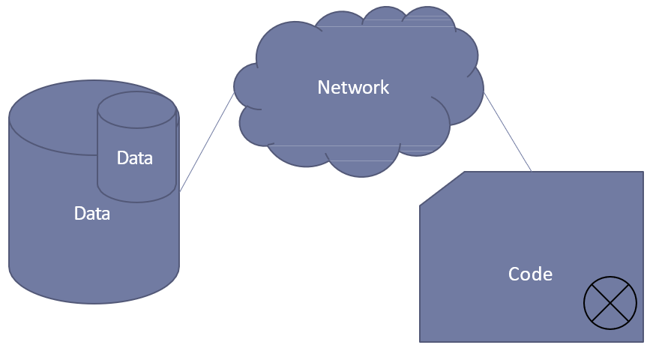
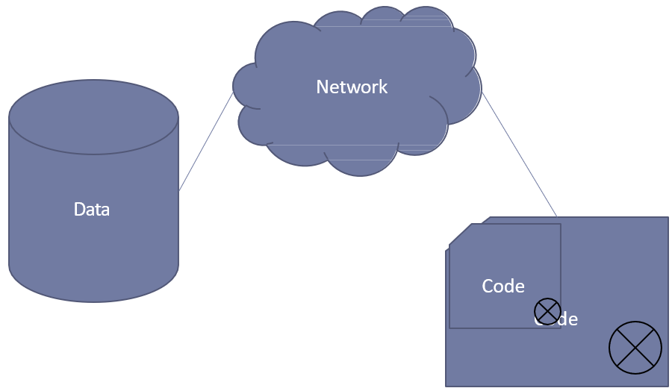
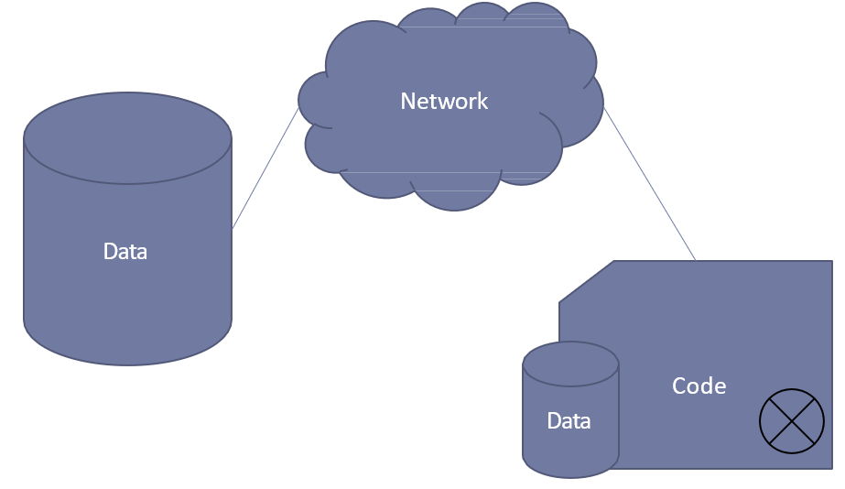
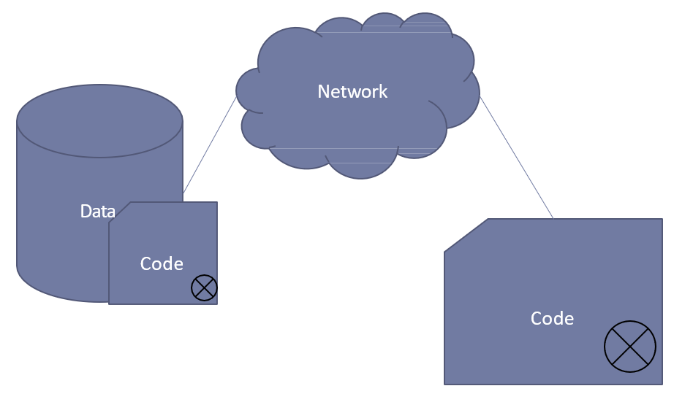
Data and Storage Paradigm Storage / Compute Locality
Scenario 1
Scenario 2
Which Scenario is preferable?
Move the processing elements (e.g., execution of code) to the locality of the data rather than moving the data for processing.
Co-locate the data and processing (a.k.a. compute)
Minimise data transfer
Limit bulk transferal of data
Notes:
https://insideBigdata.com/2020/07/14/a-modern-data-storage-paradigm-reducing-the-high-cost-of-data-management/
Storage/ compute paradigm is about the computation to the location of the data, which aligns with Hadoop's use of HDFS and MapReduce.
Compute/ storage paradigm involves the movement of data to computation, but this is less emphasized in Hadoop's architecture.

Slide 19
Distributed Computing Overview
Parallel Computing
Distributed Computing
Parallel computing uses multiple compute resources acting simultaneously to solve a computational problem
There are overlaps between parallel computing and distributed computing
For example,
The processors in the computers in a distributed system use parallelism
Distributed systems can be used to solve parts of problems in parallel

Slide 20
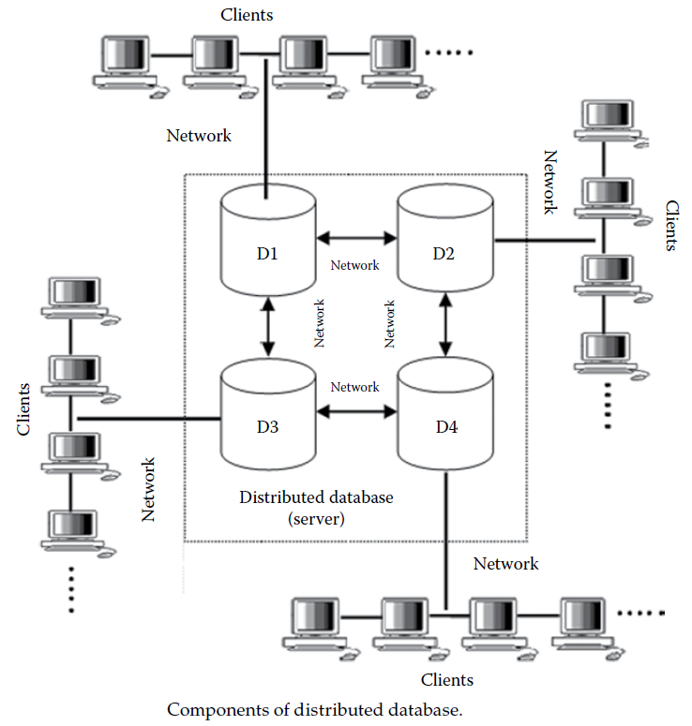
Distributed Databases
A database server is the software that administers a database, and a client is an application that requests information and seeks services from a server.
Distributed processing (DP) refers to the use of more than one computer (or processor) to run an application and perform the processing for an individual task.
DP refers to local area networks (LANs) designed so that a single program can run simultaneously at various sites.
DP is composed of distributed databases, wherein the data are stored across different computer systems.
Node
The main goal of DP system is to connect users and resources in a transparent, open, and scalable way.
Notes:
Data expands on real-time and the organizations were looking for a centralized repository can efficiently store the data, which needs to be retrieved, manipulated, and updated using some form of management system.
Database administrators are required to balance the computer’s workload to avoid peak-load problems when people across an organization want to use it.
It limits users’ flexibility in doing their own work in a centralized computing system, which has led to the swing toward decentralized/ distributed computing.
A distributed database consists of a set of interrelated databases stored on several computers distributed over a network wherein the data can be concurrently accessed and altered. The components of a distributed database include a database server and a client as shown in the Figure.
Resource sharing, Scalability, Fault tolerance/ Robustness, and Performance/ speed are other benefits of distributed processing.

Slide 21
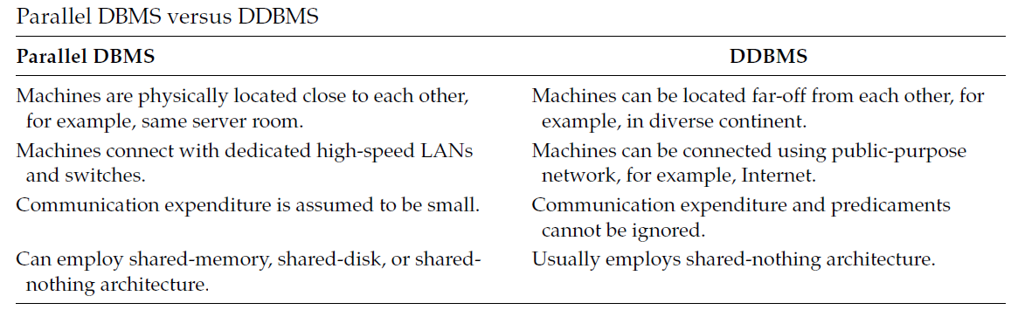
Parallel DBMS and DDBMS
Parallel Database Management Systems refers to the management of data in a tightly coupled multiprocessor computer and is done by a full-fledged DBMS.
Notes:
Predicaments: A difficult, unpleasant, or embarrassing situation.

Slide 22
Requirements and Challenges BIG DATA
Scalability
Availability and Fault Tolerance
Efficient Network Setup
Flexibility
Privacy and Access Control
Elasticity
Batch Processing and Interactive Processing
Efficient Storage
Multi-tenancy
Efficient Processing
Efficient Scheduling
Research Article (pdf copy available on Moodle)
https://www.sciencedirect.com/science/article/pii/S2214579621001064
Notes:
For Big data systems, there are a few specific research challenges as
Scalability: The foremost requirement for Big data systems is to provide massive capability for processing and storage of huge amounts of data. Scalability should be achieved without any noticeable degradation in performance.
Availability and Fault Tolerance: An efficient Big data system should be able to tolerate faults. Faults could either be transient such as network congestion, CPU availability, and packet loss, or they could be persistent such as disk failure, power faults, and network outages.
Efficient Network Setup: As Big data system consists of a large number of machines and workstations, efficient networking setup is an important requirement. The network should be capable of providing access to Big data, with low communication latency. Network setup should facilitate building Big data systems through both Local Area Network (LAN) and Wide Area Network (WAN).
Flexibility: Big data systems may contain data from multiple sources such as textual data, images, videos, and graphs. Similarly, data can be assessed and analyzed through multiple means including visualizations, raw data, aggregated data, and queries. Big data systems should facilitate flexible mechanisms for accessing and storing Big data systems.
Privacy and Access Control: As Big data systems gather data from a large number of sources, privacy and access control are likely to be one of the major concerns. Questions such as which data should be made public, what information should be assessed, and who has the ownership of data are important and needed to be identified.
Elasticity: In a Big data system, the number of users varies over time. An efficient system should be able to meet user’s needs. Elasticity refers to the capability of the system in meeting these needs.
Batch Processing and Interactive Processing: With the passage of time, Big data systems have expanded from batch processing to interactive processing. For capable Big data systems, possessing the ability to analyze and process Big data in batch mode as well streaming mode is necessary.
Efficient Storage: As data is replicated in Big data systems, efficient mechanisms for replication and storage are significant in reducing the overall cost.
Multi-tenancy: Big data systems are accessed by multiple users at a time. Multitenancy refers to the capability of the system in providing fair, persistent, and isolated services to the users of Big data.
Efficient Processing: As data is massive, efficient algorithms, techniques, and hardware are needed for large-scale computation of Big data. In this context, effective techniques for parallelization are also significant. Similarly, iterative computation for machine learning and data analytics are also important.
Efficient Scheduling: With multiple parallel tasks and concurrent users, methods and techniques for efficient scheduling are needed.

Slide 23
Questions and Discussion
How many architectures are present in Big Data processing?
Which data and storage paradigm (Storage/ Compute) is considered as useful for Big Data Storage and Processing applications?
Express your understanding in your own words for parallel and distributed computing. Which programming model is useful for distributed processing using a Big data framework?

Slide 24
Resources/ References
Big Data: Concepts, Technology, and Architecture, Balamurugan Balusamy, Nandhini Abirami R, Seifedine Kadry, Amir H. Gandomi, ISBN: 978-1-119-70187-3, March 2021, 368 pages.
Big Data Systems: A 360-degree Approach, Jawad Ahmed Shamsi, Muhammad Ali Khojaye, CRC Press, 2021.
NoSQL Database for Storage and Retrieval of Data in Cloud, Ganesh Chandra Deka, CRC Press, Taylor & Francis Group, 6000 Broken Sound Parkway NW, 2017.
Big Data: Principles And Best Practices Of Scalable Real-time Data Systems, Nathan Marz, James Warren, Manning Publications, 2015.
Greg Schulz, 2012, Cloud and Virtual Storage Networking, CRC Press.
G. Somasundaram, A Shrivastava (Editors), 2009, Information Storage and Management: Storing, Managing, and Protecting Digital Information, Wiley Publishing
Some images are used from Google search repository.

